Slide 1
ETHICAL HACKING
Ders 9 – Computer network

Slide 2
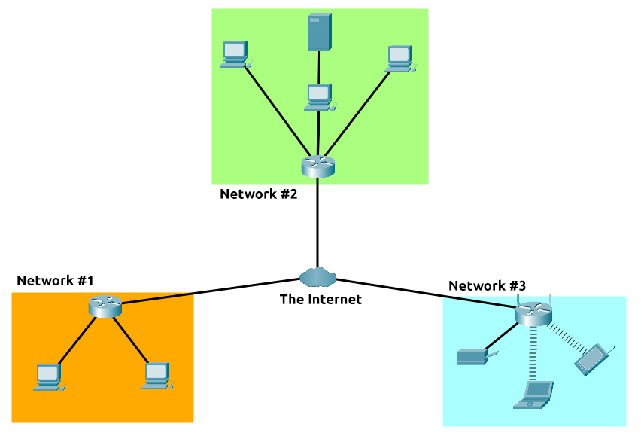
What is networking?

Slide 3
Types of area networks
The Network allows computers to connect and communicate with different computers via any medium. LAN, MAN, and WAN are the three major types of networks designed to operate over the area they cover. There are some similarities and dissimilarities between them. One of the major differences is the geographical area they cover, i.e. LAN covers the smallest area, MAN covers an area larger than LAN and WAN comprises the largest of all.

Slide 4
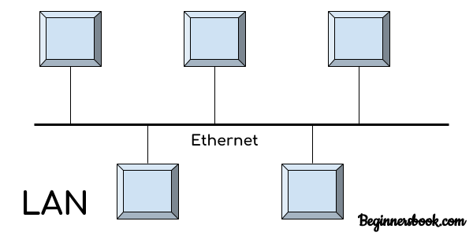
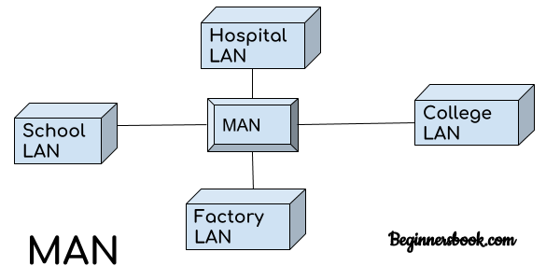
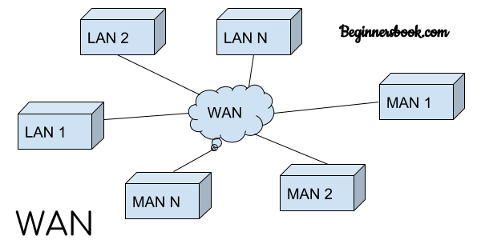

Slide 5
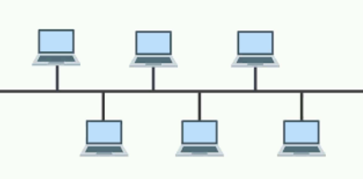
Local Area Network (LAN) Topologies: Bus Topology
The original topology in the early systems was a bus topology. Each of the devices is strung together in a single line. Each device can tap into the bus to send and receive packets. Every node can see every packet sent over the bus. Each device has to examine each packet to determine if the packet is intended for them. The advantage to the bus topology is that it is cheap and simple, while the disadvantage is that on a busy network, it can easily become congested.

Slide 6
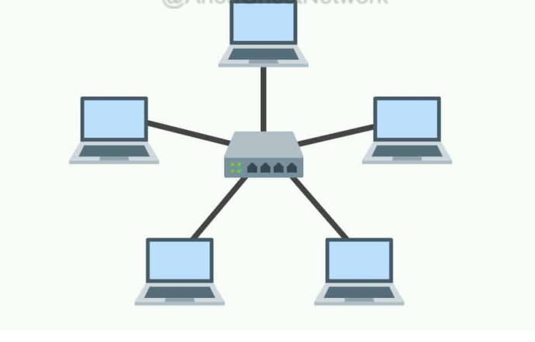
Star topology
The star topology is the most popular topology for local area networks (LAN). In the star topology, there is a server at the center of the star, and the clients all connect to the server. The advantage of this topology is that the connections to each of the clients are independent, and if one client or its connection is broken, the others clients can still communicate with the server.

Slide 7
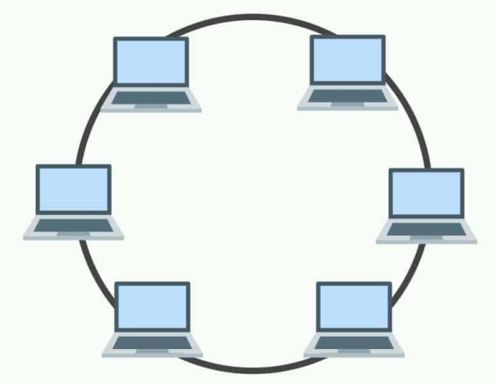
Ring topology
The ring topology sends the packets around a ring, and only the client the packet is intended for can grab the packet from the ring. The advantage of the ring topology is that it is simple and inexpensive, but if the ring is broken, all clients cannot receive any communication.

Slide 8
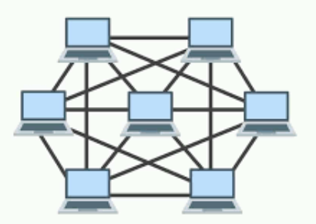
Mesh topology
The mesh topology has many connections between each device on the network. This means that a packet has a variety of paths to take to its destination. This gives the network resiliency in the case that one cable or path is broken. This is similar to how our modern internet is connected; packets have multiple paths they can take to the target system.

Slide 9
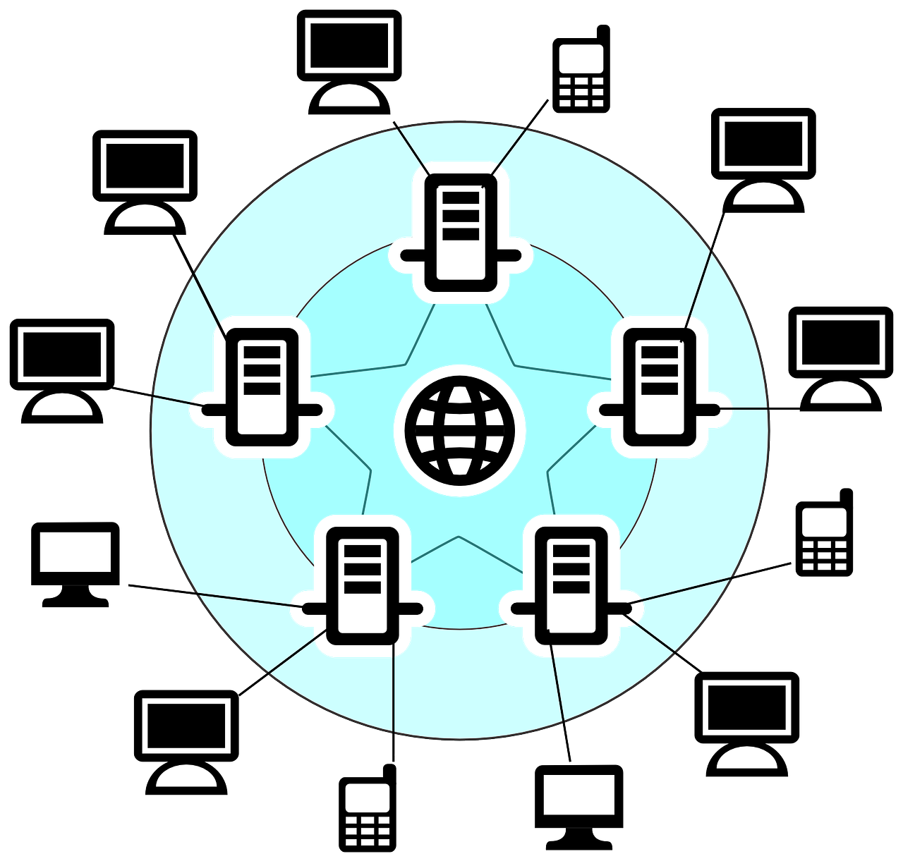
Internet
A network of networks is called an internetwork, or simply the internet. It is the
largest network in existence on this planet. The internet hugely connects all WANs and it can have connection to LANs and Home networks. Internet uses TCP/IP protocol suite and uses IP as its addressing protocol. To inter-connect various continents, fibers are laid under sea known to us as submarine communication cable.

Slide 10
Types of communication
Unicast
Multicast
Broadcast
Multicast is group communication where data transmission is addressed to a group of destination computers simultaneously. Multicast can be one-to-many or many-to-many distribution.
Broadcasting is a method of transferring a message to all recipients simultaneously. Broadcasting can be performed as a high-level operation in a program or it may be a low-level operation.
One-to-one transmission from one point in the network to another point; that is, one sender and one receiver, each identified by a network address.

Slide 11
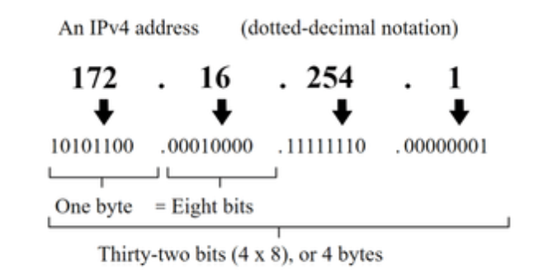
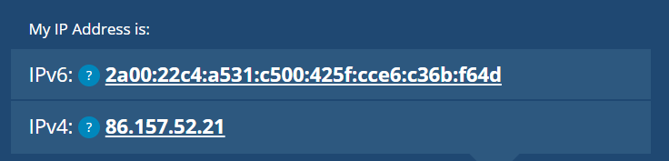
IP ADDRESSES
An IP Address is basically classified into two types:
Private IP Address
Public IP Address
Public IP Address is basically of two types:
Dynamic IP addresses: Dynamic IP Addresses are addresses that change over time. After establishing a connection of a smartphone or computer with the Internet, ISP provides an IP Address to the device, these random addresses are called Dynamic IP Address.
Static IP addresses : Static Addresses are those addresses that do not change with time. These are stated as permanent internet addresses mostly by DNS
IPv6 is a new iteration of the Internet Protocol addressing scheme to help tackle this issue. Although it is seemingly more daunting, it boasts a few benefits:
Supports up to 2^128 of IP addresses (340 trillion-plus), resolving the issues faced with IPv4
More efficient due to new methodologies

Slide 12
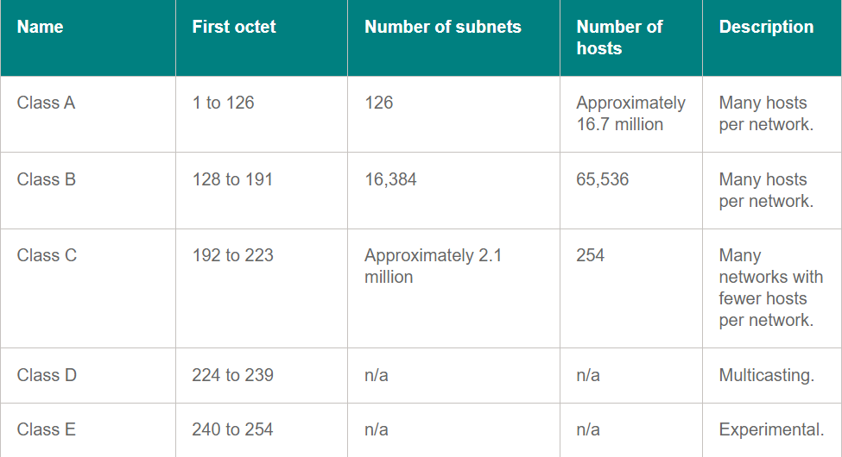
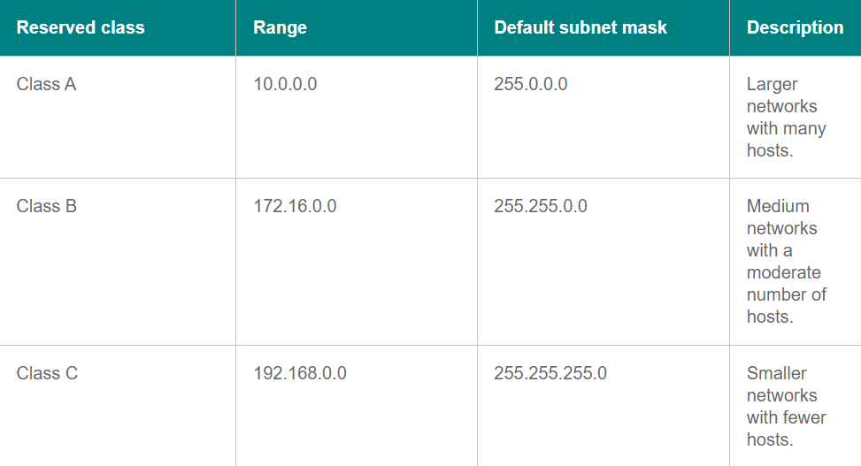
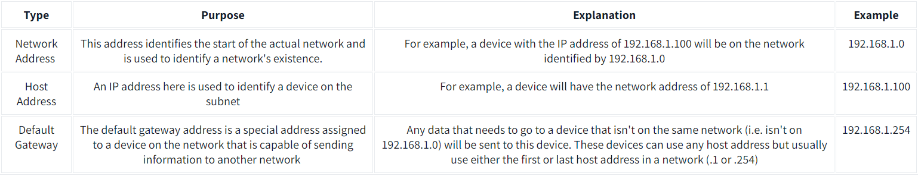
Subnetting

Slide 13
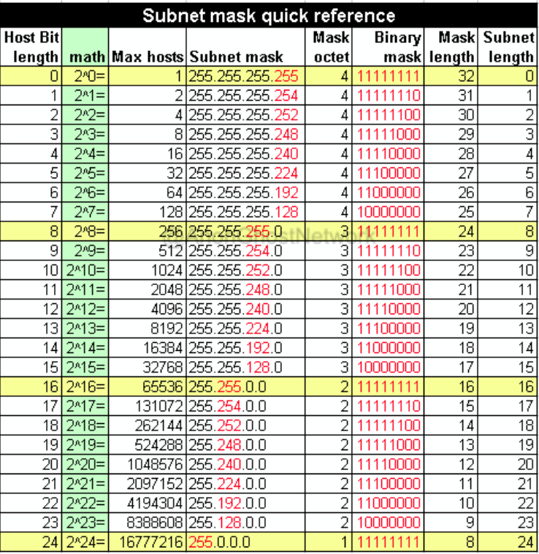
Subnetting
CIDR Notation
CIDR, or Classless Inter-Domain Routing notation, is a way of representing an IP address and the network mask associated with it. CIDR notation specifies an IP address, a slash (/), and a decimal number such as 192.168.1.0/24, where the 24 represents the number of bits in the network mask
Divide a Class C network (such as 192.168.1.0/24) into five different subnets, each with no more than 30 hosts,

Slide 14
Subnetting
Class A:
Range: 1.0.0.0 to 126.0.0.0
Subnet Mask: 255.0.0.0 (/8 prefix)
Number of Networks: 128 (2^7)
Number of Hosts per Network: Approximately 16,777,214 (2^24 - 2)
Class B:
Range: 128.0.0.0 to 191.255.0.0
Subnet Mask: 255.255.0.0 (/16 prefix)
Number of Networks: 16,384 (2^14)
Number of Hosts per Network: Approximately 65,534 (2^16 - 2)
Class C:
Range: 192.0.0.0 to 223.255.255.0
Subnet Mask: 255.255.255.0 (/24 prefix)
Number of Networks: 2,097,152 (2^21)
Number of Hosts per Network: Approximately 254 (2^8 - 2)
Class D (Multicast addresses):
Range: 224.0.0.0 to 239.255.255.255
Class D addresses are used for multicast traffic, and they are not divided into networks or hosts in the traditional sense.
Class E (Experimental addresses):
Range: 240.0.0.0 to 255.255.255.255
Class E addresses are reserved for experimental purposes, and they are not divided into networks or hosts.

Slide 15
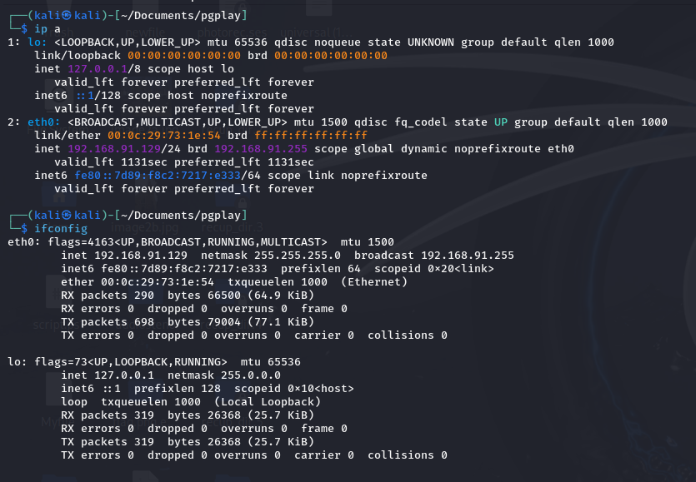
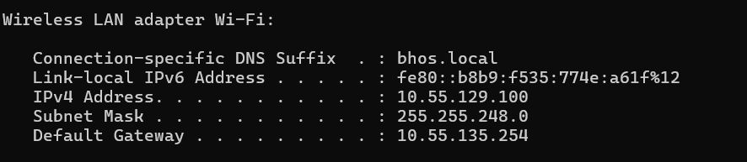

Slide 16
Network Address resolution (NAT)
Network Address Translation (NAT) is a process in which one or more local IP addresses are translated into one or more Global IP addresses and vice versa to provide Internet access to the local hosts. It also does the translation of port numbers, i.e., masks the port number of the host with another port number in the packet that will be routed to the destination. It then makes the corresponding entries of IP address and port number in the NAT table. NAT generally operates on a router or firewall.
Types of NAT:
Static
Dynamic
PAT

Slide 17
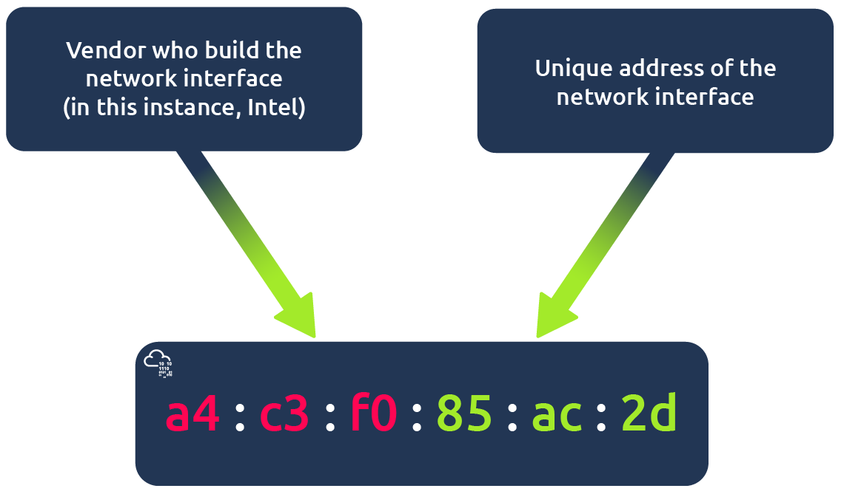
MAC(Media Access Control) Addresses

Slide 18
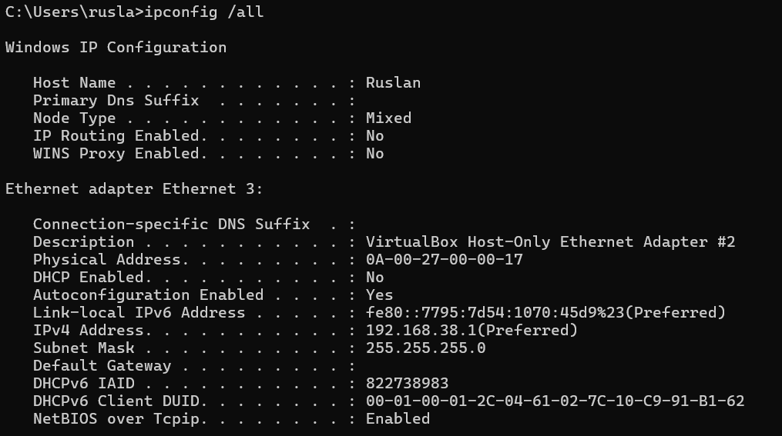
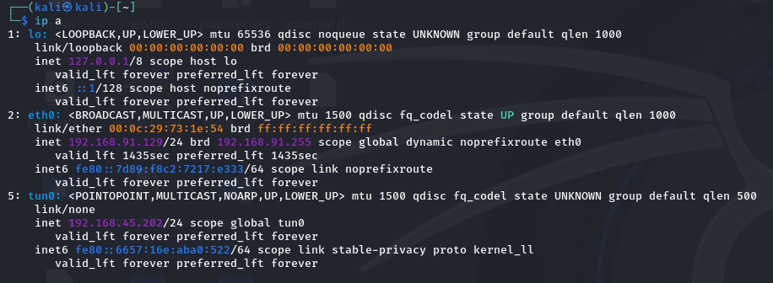
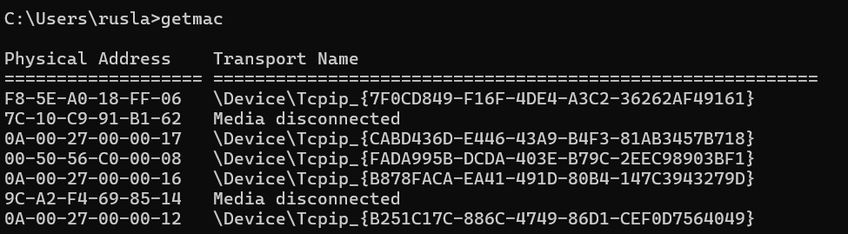
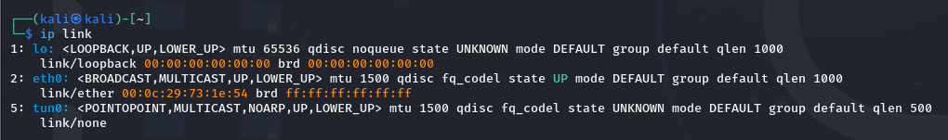

Slide 19
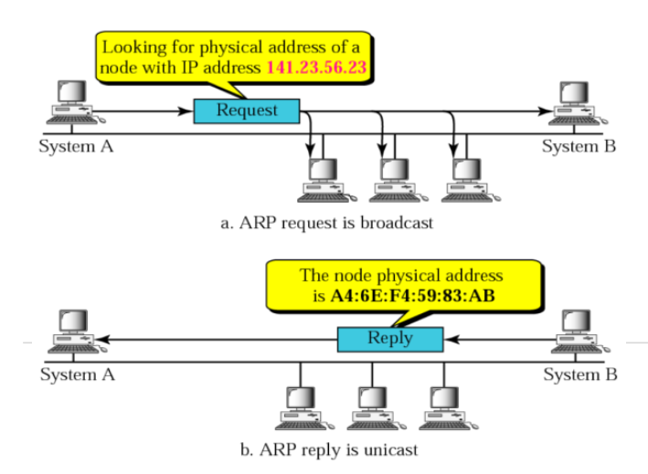
ARP
Address Resolution Protocol (or ARP as it is commonly known) is used on Ethernet networks to assign IP addresses to globally unique MAC addresses. In this way, when a new system enters the
network, its MAC address is assigned an IP address within the range of IP addresses on the network.

Slide 20
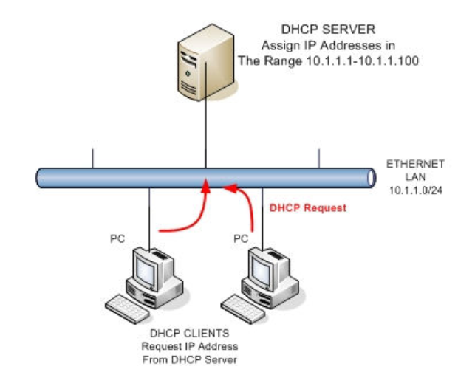
DHCP
1. Discovery (DHCPDISCOVER)
When a computer (client) is connected to the network and doesn't have an IP address, it broadcasts a DHCPDISCOVER message on the network.
This message is sent to the entire network using a broadcast IP address (255.255.255.255), because the client doesn't yet know the address of the DHCP server.
The DHCPDISCOVER message essentially asks if there are any DHCP servers available to assign an IP address.
2. Offer (DHCPOFFER)
Any DHCP server on the network that receives the DHCPDISCOVER message responds by sending a DHCPOFFER message back to the client.
The DHCPOFFER message contains the IP address being offered to the client, along with other network configuration details (like the subnet mask, default gateway, DNS servers, and the IP lease duration).
This message is also broadcasted to ensure it reaches the client.
3. Request (DHCPREQUEST)
The client receives one or more DHCPOFFER messages and chooses one (if multiple DHCP servers responded).
The client then broadcasts a DHCPREQUEST message to the network, indicating which offer it is accepting.
This message informs all DHCP servers that the client has accepted the offer from a specific DHCP server, and the other servers can withdraw their offers.
4. Acknowledge (DHCPACK)
The DHCP server that made the accepted offer responds with a DHCPACK (acknowledgment) message.
This message confirms that the client can use the IP address for a specified lease time.
The client now officially has an IP address and can start communicating on the network.

Slide 21
DNS
DNS was designed to translate a domain name--something people are rather good at remembering--into an IP address, the language of Internet Routing. Think of DNS as simply a translation of a domain name to the respective IP addresses. Domain names must be registered with ICANN (Internet Corporation for Assigned Names and Numbers), usually through an intermediary such as VeriSign or GoDaddy.

Slide 22
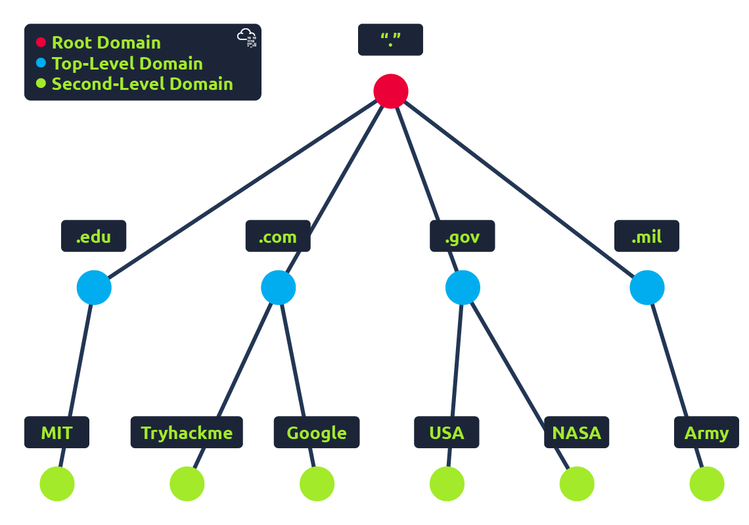
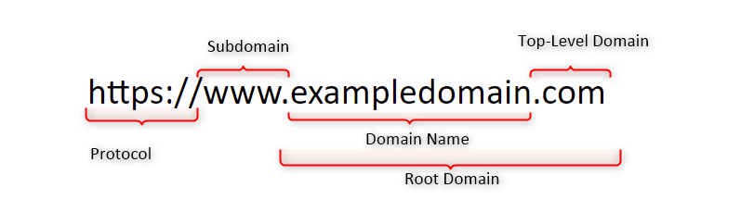
DNS
Second-Level Domain
(maximum 63 characters)
Subdomain
(total length maximum 253 characters)

Slide 23
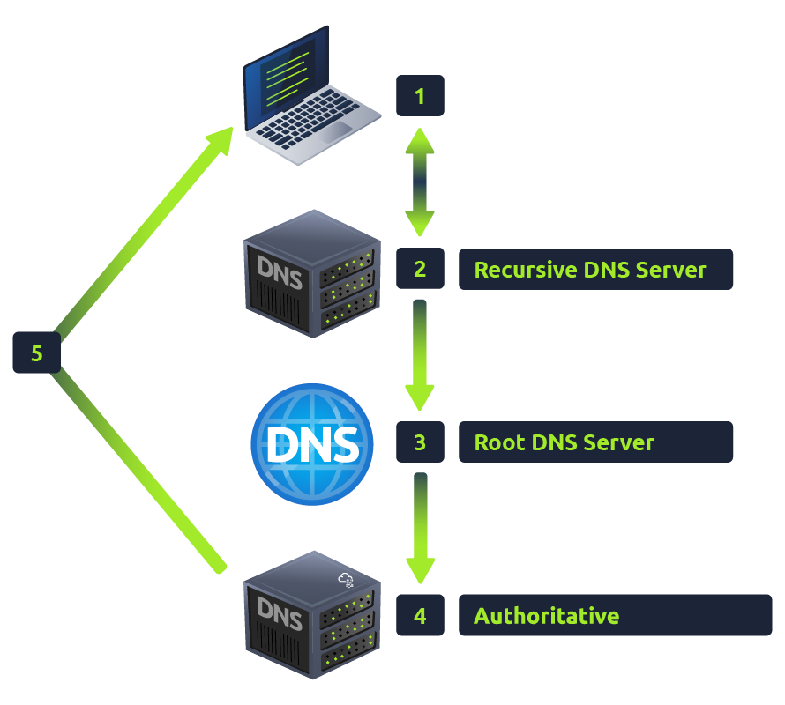
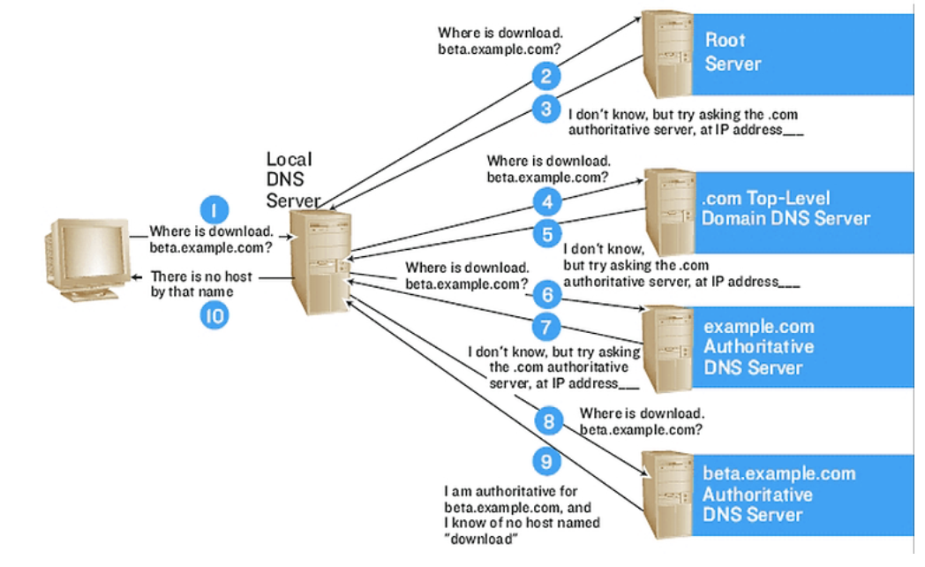
DNS

Slide 24
DNS
DNS service components:
1. DNS Cache
2. Resolvers
3. Name servers
4. Name space.

Slide 25
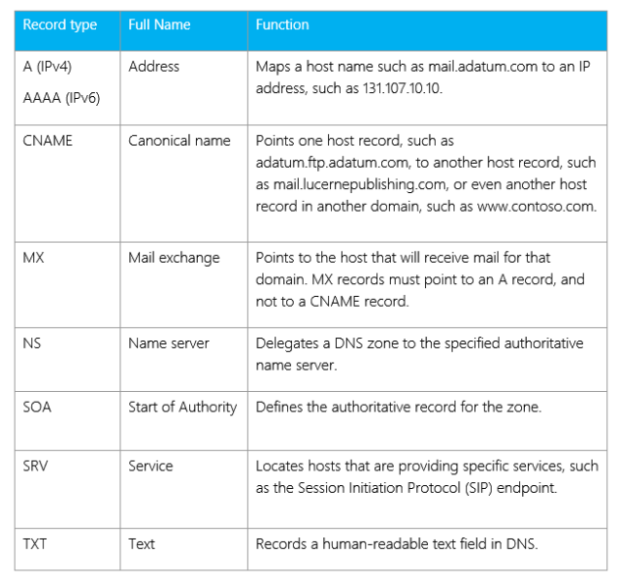
DNS Records

Slide 26
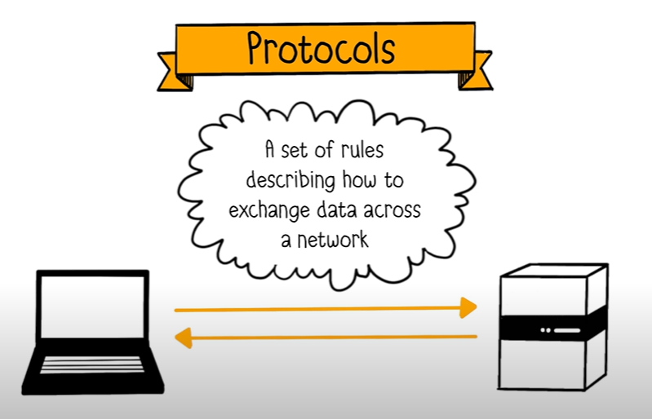
Ports and protocols

Slide 27
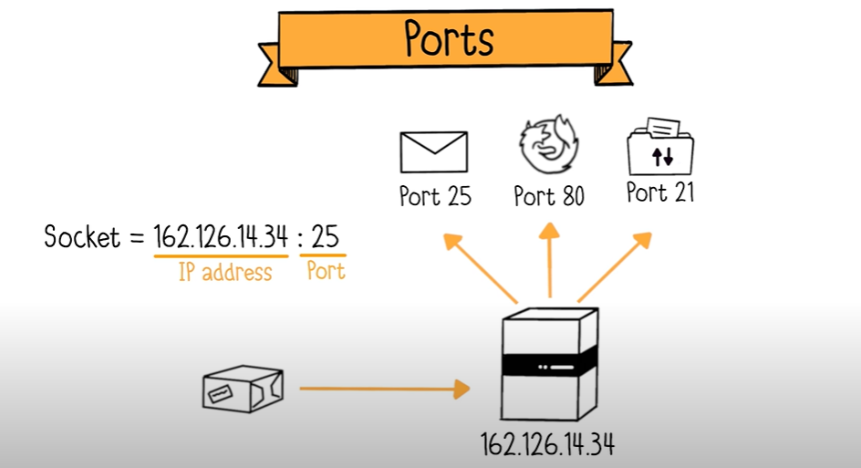
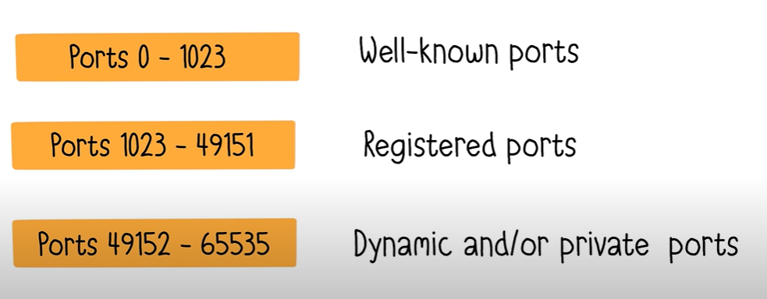
Ports and protocols

Slide 28
Ports and protocols
Port Number | Protocol/Service | Description
20 | FTP (Data Transfer) | File Transfer Protocol (data channel)
21 | FTP (Control) | File Transfer Protocol (control channel)
22 | SSH | Secure Shell (encrypted remote login)
23 | Telnet | Unencrypted text communications
25 | SMTP | Simple Mail Transfer Protocol (email)
53 | DNS | Domain Name System (name resolution)
67 | DHCP (Server) | Dynamic Host Configuration Protocol (IPv4)
68 | DHCP (Client) | Dynamic Host Configuration Protocol (IPv4)
80 | HTTP | HyperText Transfer Protocol (web browsing)
110 | POP3 | Post Office Protocol v3 (email retrieval)
123 | NTP | Network Time Protocol
137-139 | NetBIOS | Network Basic Input/Output System
143 | IMAP | Internet Message Access Protocol (email)
161 | SNMP | Simple Network Management Protocol
162 | SNMP (Trap) | SNMP Trap (alerts from network devices)
389 | LDAP | Lightweight Directory Access Protocol
443 | HTTPS | HTTP Secure (encrypted web traffic)
445 | SMB/CIFS | Server Message Block (Windows file sharing)
465 | SMTPS | SMTP Secure (email)
587 | SMTP (submission) | SMTP Secure submission for email
1433 | MSSQL | Microsoft SQL Server
1521 | Oracle DB | Oracle Database
3306 | MySQL | MySQL Database
3389 | RDP | Remote Desktop Protocol (Windows)
5432 | PostgreSQL | PostgreSQL Database

Slide 29
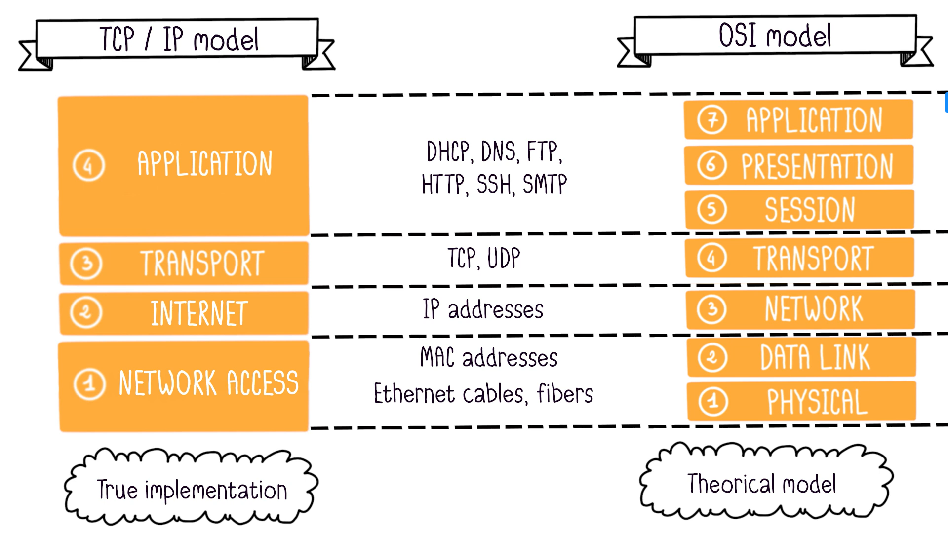
Models of networking : TCP / IP and OSI models
Notes:
https://media.licdn.com/dms/image/v2/D4D22AQH9ZI_U54s22Q/feedshare-shrink_1280/feedshare-shrink_1280/0/1726560285106?e=1730937600&v=beta&t=PurWvXdemKw3Ik35HF1OjcDMYRga76YZKop-t3FWQ-s

Slide 30
Application Layer in OSI Model
Services Provided by Application Layer
The services provided by application layer in OSI model are:
It provides interface between user and application.
It is used for remote login.
It is used for file transfer.
It is used for mail services and transfers.
It is also used to transfer multimedia files.
It is used for resource sharing.
It is used for data synchronization.
It is used for authentication services.
Protocols used:
1) TELNET
2) FTP
3) TFTP
4) NFS
5) SMTP
6) LPD
7) SNMP
8) DNS
9) DHCP
10)HTTP/HTTPS
11)Pop
12)Mime
Notes:
https://media.licdn.com/dms/image/v2/D4D22AQH9ZI_U54s22Q/feedshare-shrink_1280/feedshare-shrink_1280/0/1726560285106?e=1730937600&v=beta&t=PurWvXdemKw3Ik35HF1OjcDMYRga76YZKop-t3FWQ-s

Slide 31
Presentation Layer in OSI Model
Presentation layer format and encrypts data to be sent across the network.
This layer carries out data compression to reduce the bandwidth of the data to be transmitted
Presentation layer is also responsible for translation, formatting, and delivery of information for processing or display
Protocols used:
SSL
Notes:
https://media.licdn.com/dms/image/v2/D4D22AQH9ZI_U54s22Q/feedshare-shrink_1280/feedshare-shrink_1280/0/1726560285106?e=1730937600&v=beta&t=PurWvXdemKw3Ik35HF1OjcDMYRga76YZKop-t3FWQ-s

Slide 32
Session Layer in OSI Model
This layer is also responsible for session checkpointing and recovery.
This layer basically provides a mechanism of opening, closing and managing a session between the end-user application processes.
The session Layer is responsible for fetching or receiving data information from its previous layer (transport layer) and further sends data to the layer after it (presentation layer).
Protocols used:
RPC
2) PPTP
Notes:
https://media.licdn.com/dms/image/v2/D4D22AQH9ZI_U54s22Q/feedshare-shrink_1280/feedshare-shrink_1280/0/1726560285106?e=1730937600&v=beta&t=PurWvXdemKw3Ik35HF1OjcDMYRga76YZKop-t3FWQ-s

Slide 33
Transport Layer in OSI Model
OSI Layer | Data Unit | Encapsulated Info
Application Layer | Data | User data
Presentation Layer | Data | Data format (e.g., encoding)
Session Layer | Data | Session information
Transport Layer | Segment/Datagram | Port numbers, error detection, flow control
Network Layer | Packet | IP addresses (source, destination)
Data Link Layer | Frame | MAC addresses, FCS
Physical Layer | Bits | Binary transmission
The transport layer, or layer 4 of the OSI model, controls network traffic between hosts and end systems to guarantee full data flows. The transport layer receives the formatted data from the upper layers, performs Segmentation , and also implements Flow and error control to ensure proper data transmission.
Protocols used:
TCP, UDP , PPTP
Notes:
https://media.licdn.com/dms/image/v2/D4D22AQH9ZI_U54s22Q/feedshare-shrink_1280/feedshare-shrink_1280/0/1726560285106?e=1730937600&v=beta&t=PurWvXdemKw3Ik35HF1OjcDMYRga76YZKop-t3FWQ-s

Slide 34
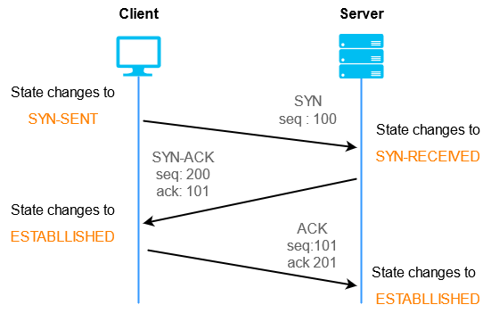
Transport Layer in OSI Model
Services Provided by Transport Layer
Connection-Oriented Service
Connectionless Service
Feature | Connectionless Service (UDP) | Connection-Oriented Service (TCP)
Connection Setup | No | Yes (e.g., TCP 3-way handshake)
Acknowledgment | No | Yes
Reliability | Unreliable, no recovery | Reliable, ensures error recovery
Speed | Faster | Slower due to connection overhead
Packet Ordering | Not guaranteed | Guaranteed
Usage | Streaming, DNS, gaming | Web browsing, file transfers

Slide 35
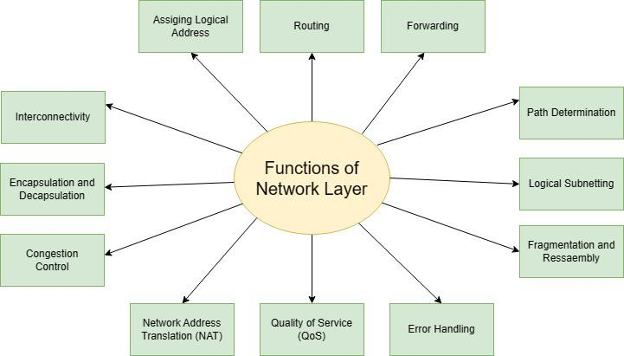
Network Layer in OSI Model
Protocols used:
IP
IPsec
ICMP
GRE, OSPF, BGP

Slide 36
Network Layer in OSI Model
OSI Layer | Data Unit | Encapsulated Info
Application Layer | Data | User data
Presentation Layer | Data | Data format (e.g., encoding)
Session Layer | Data | Session information
Transport Layer | Segment/Datagram | Port numbers, error detection, flow control
Network Layer | Packet | IP addresses (source, destination)
Data Link Layer | Frame | MAC addresses, FCS
Physical Layer | Bits | Binary transmission
Packetizing, Forwarding and Routing are the three general services offered by Network Layer.
Devices used:
Routers
Layer 3 Switches

Slide 37
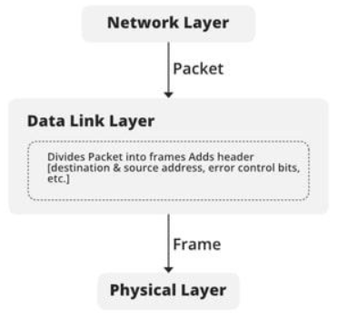
Data Link Layer in OSI Model
OSI Layer | Data Unit | Encapsulated Info
Application Layer | Data | User data
Presentation Layer | Data | Data format (e.g., encoding)
Session Layer | Data | Session information
Transport Layer | Segment/Datagram | Port numbers, error detection, flow control
Network Layer | Packet | IP addresses (source, destination)
Data Link Layer | Frame | MAC addresses, FCS
Physical Layer | Bits | Binary transmission
Devices used:
Bridges
Switches

Slide 38
Physical Layer in OSI Model
The physical Layer is the bottom-most layer in the Open System Interconnection (OSI) Model which is a physical and electrical representation of the system. It consists of various network components such as power plugs, connectors, receivers, cable types, etc.
OSI Layer | Data Unit | Encapsulated Info
Application Layer | Data | User data
Presentation Layer | Data | Data format (e.g., encoding)
Session Layer | Data | Session information
Transport Layer | Segment/Datagram | Port numbers, error detection, flow control
Network Layer | Packet | IP addresses (source, destination)
Data Link Layer | Frame | MAC addresses, FCS
Physical Layer | Bits | Binary transmission
Modes of Transmission Medium
Simplex mode: In this mode, out of two devices, only one device can transmit the data, and the other device can only receive the data. Example- Input from keyboards, monitors, TV broadcasting, Radio broadcasting, etc.
Half Duplex mode: In this mode, out of two devices, both devices can send and receive the data but only one at a time not simultaneously. Examples- Walkie-Talkie, Railway Track, etc.
Full-Duplex mode: In this mode, both devices can send and receive the data simultaneously. Examples- Telephone Systems, Chatting applications, etc.

Slide 39
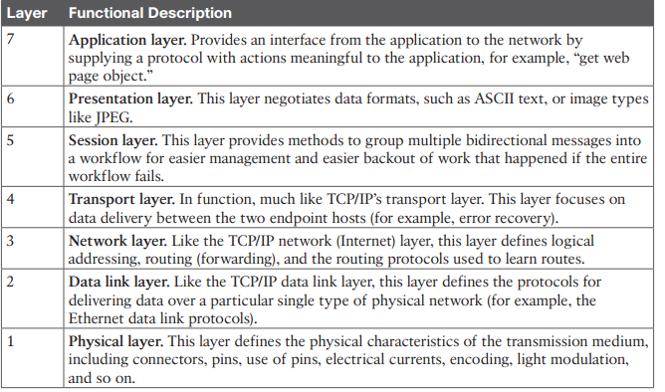
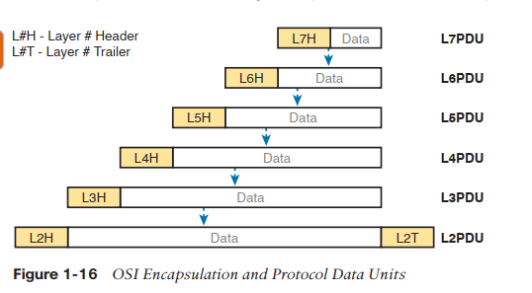
Notes:
https://media.licdn.com/dms/image/v2/D4D22AQH9ZI_U54s22Q/feedshare-shrink_1280/feedshare-shrink_1280/0/1726560285106?e=1730937600&v=beta&t=PurWvXdemKw3Ik35HF1OjcDMYRga76YZKop-t3FWQ-s

Slide 40
Common Security Attacks in the OSI Layer Model
OSI Layer | Common Attacks | Description
Layer 7 (Application) | SQL Injection, XSS, Phishing, Malware, DoS/DDoS | Exploiting vulnerabilities in applications, web services, and protocols.
Layer 6 (Presentation) | SSL Stripping, Data Manipulation | Intercepting or manipulating data encryption and format.
Layer 5 (Session) | Session Hijacking, Man-in-the-Middle (MitM) | Taking over or manipulating active sessions between users and servers.
Layer 4 (Transport) | TCP SYN Flood, Port Scanning, Session Hijacking | Overloading transport protocols (TCP/UDP) to disrupt communication or scan for open ports.
Layer 3 (Network) | IP Spoofing, Routing Attacks (e.g., BGP Hijacking) | Manipulating or spoofing IP addresses to impersonate devices or reroute traffic.
Layer 2 (Data Link) | ARP Spoofing, MAC Flooding, VLAN Hopping | Exploiting vulnerabilities in network data frames, MAC addresses, and VLANs.
Layer 1 (Physical) | Wiretapping, Jamming, Physical Tampering | Interfering with or physically accessing network cables, wireless signals, or devices.
Notes:
https://media.licdn.com/dms/image/v2/D4D22AQEVYIitubpkJQ/feedshare-shrink_1280/feedshare-shrink_1280/0/1723032771641?e=1738195200&v=beta&t=vARKzp_c2tx7beV1BXmRvxUcpKJSgaX2Z6LZ7RxwmNo

Slide 41
VPN
A virtual private network (VPN) is a technology that creates a safe and encrypted connection over a less secure network, such as the Internet. A Virtual Private Network is a way to extend a private network using a public network such as the Internet. The name only suggests that it is a “Virtual Private Network”, i.e. user can be part of a local network sitting at a remote location. It makes use of tunneling protocols to establish a secure connection.

Slide 42
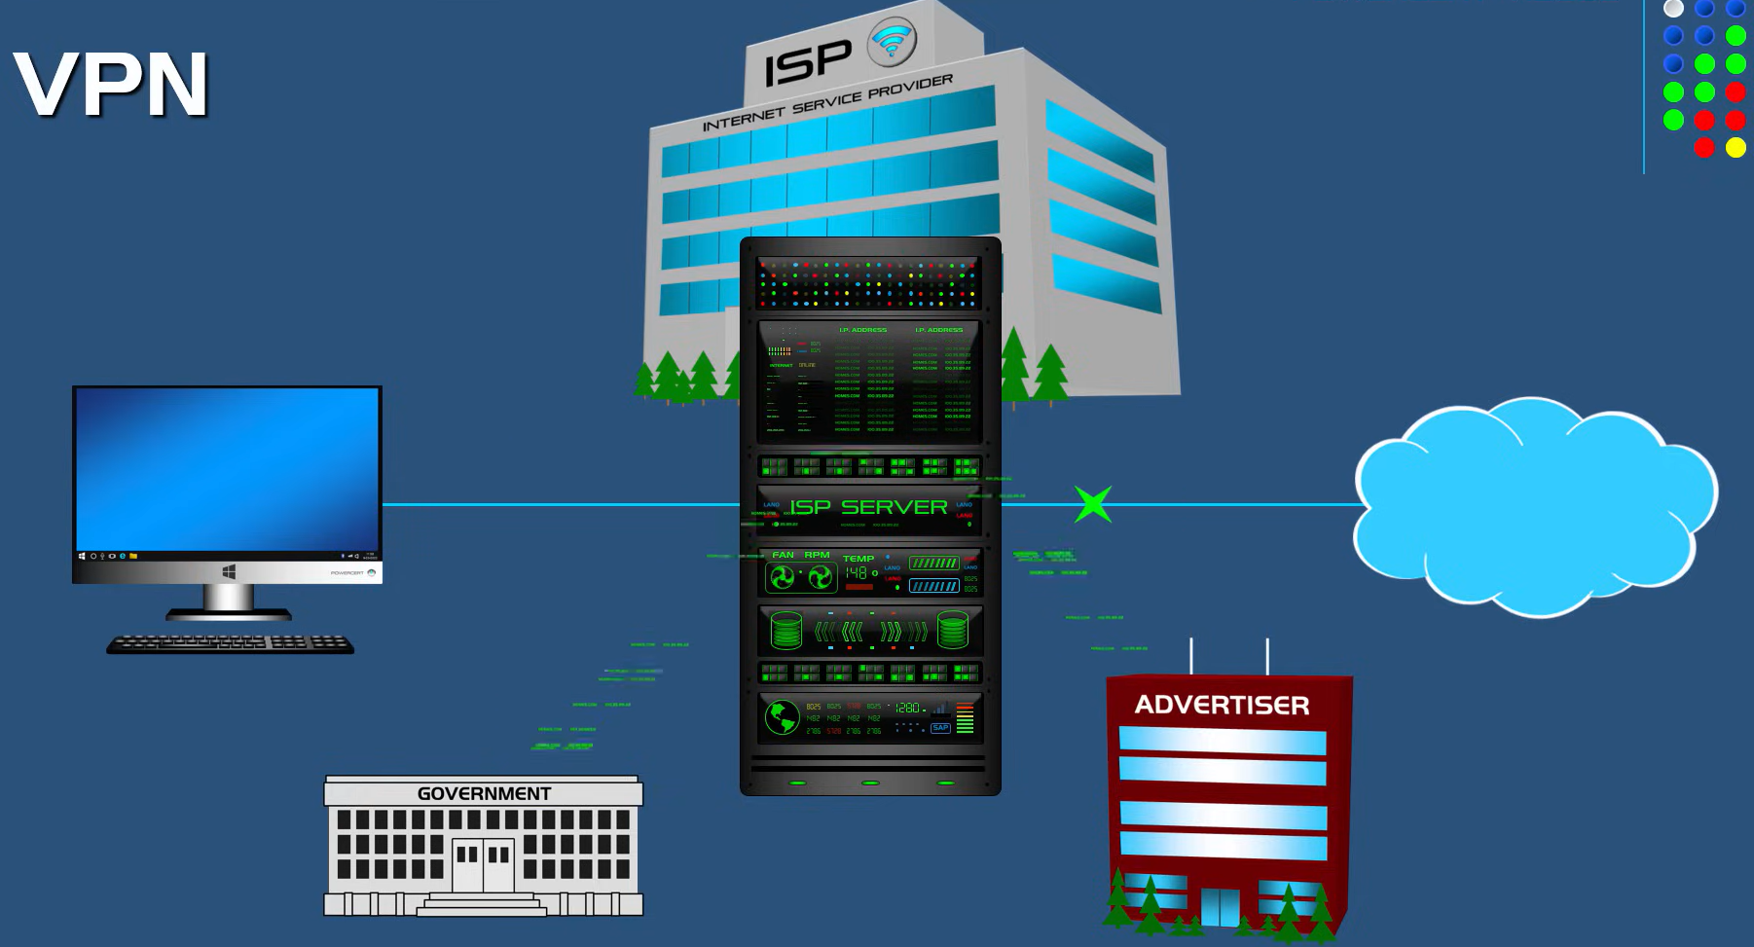
VPN

Slide 43
VPN
VPN Tunnel Creation
Encryption: After authentication, the VPN creates an encrypted "tunnel" between the user’s device and the VPN server. All the data passing through this tunnel is encrypted, protecting it from eavesdroppers, hackers, and other threats.
Protocols: VPN tunneling protocols help establish the encrypted connection. Common VPN protocols include:
IPsec: Internet Protocol Security (used for site-to-site and remote access VPNs).
OpenVPN: Uses SSL/TLS encryption, often regarded as highly secure.
L2TP/IPsec: Layer 2 Tunneling Protocol combined with IPsec for encryption.
PPTP: Older and less secure, but faster.
Data Transmission
Data Encapsulation: Once the VPN tunnel is established, any data you send or receive (like web traffic, emails, file transfers) is encrypted by the VPN client before it leaves your device. It is encapsulated in an outer layer of encryption, ensuring that no one can intercept or decipher it.
Routing: The encrypted data packets are sent through the VPN tunnel to the VPN server, which then decrypts the data and forwards it to the appropriate destination (e.g., websites, services, or an internal company network)..

Slide 44
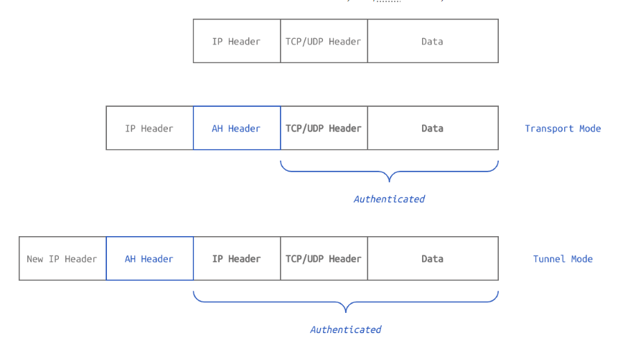
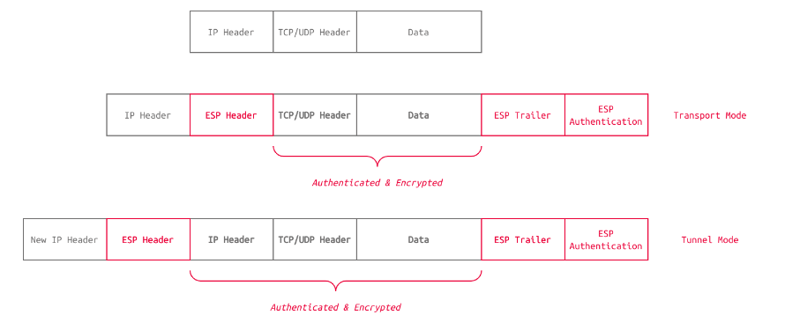
VPN
IPsec uses the following protocols:
Authentication Header (AH): Provides authentication and integrity.
Encapsulating Security Payload (ESP): Provides authentication, integrity, and confidentiality.
Security Association (SA): Is responsible for negotiating the encryption keys and algorithms. One example is Internet Key Exchange (IKE.

Slide 45
Type of VPN
Aspect | Remote Access VPNs | Site-to-Site VPNs
Functionality | Individual user access to a central network from disparate locations | Securely linking entire networks across different geographical locations or branch offices
Purpose | Prioritizes individual user connections for remote access to a centralized network | Concentrates on interconnecting entire networks situated across multiple locations for seamless communication and resource sharing between distinct network infrastructures
Advantages | – Resource Utilization: Allows employees to access critical applications or files without local installations. – Cost-Efficiency: Reduces operational costs by eliminating the need for dedicated leased lines or physical hardware setups. – Scalability: Easily scaled to accommodate a growing remote workforce, with a flexible solution. | – Network Segmentation: Facilitates network segmentation, ensuring controlled access to designated resources. – Redundancy and Failover: Offers redundancy and failover capabilities for continuous communication. – Centralized Management: Streamlines management with centralized configuration and control of network policies and access rights.
Disadvantages | – Scalability Concerns: Multiple user connections might strain network resources. – Potential Security Risks: If not properly configured, could present vulnerabilities. | – Complex Setup: Requires specialized expertise and resources for configuration and maintenance. – Limited Flexibility: May not be as flexible for individual user access compared to Remote Access VPNs.
Optimal Use Cases | Excel in providing individual user accessibility | Shine in facilitating network-to-network connections
Types of VPN
There are several types of VPN and these are vary from specific requirement in computer network. Some of the VPN are as follows:
Remote Access VPN
Site to Site VPN
Cloud VPN
Mobile VPN
SSL VPN

Slide 46
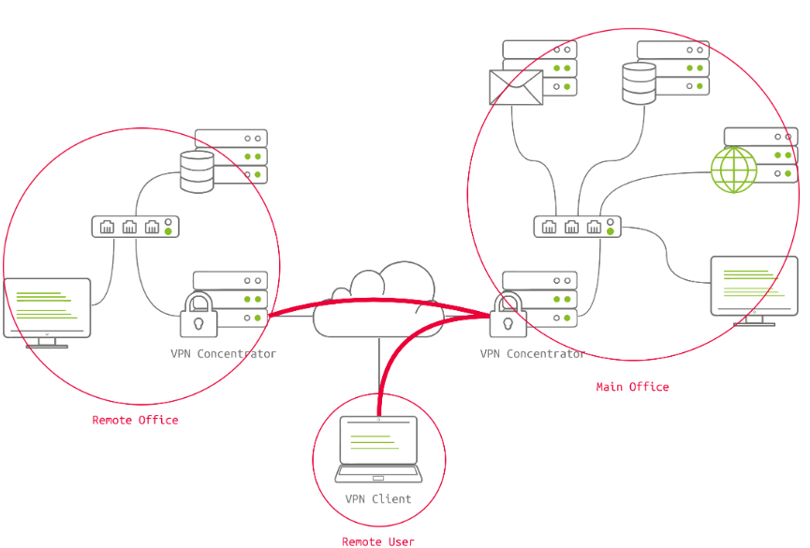
VPN

Slide 47
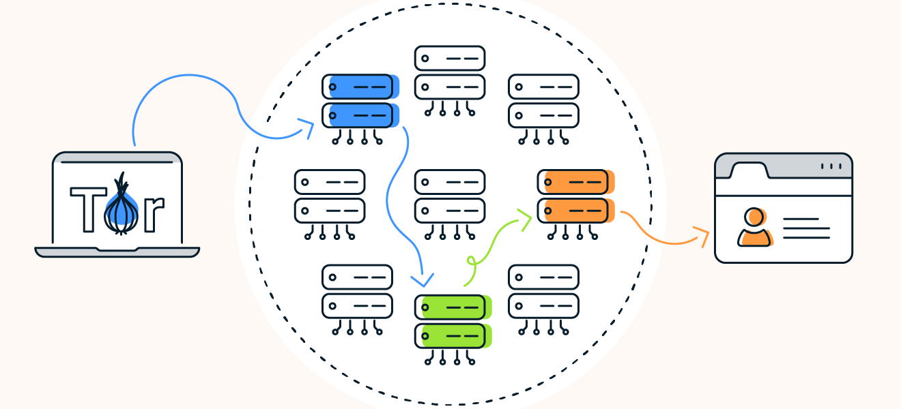
Tor

Slide 48
Firewalls
A firewall is a device within a network responsible for determining what traffic is allowed to enter and exit. Think of a firewall as border security for a network. An administrator can configure a firewall to permit or deny traffic from entering or exiting a network based on numerous factors such as:
Types of Firewalls: 1) Stateless(Packet-Filtering Firewall)
2) Statefull(Dynamic Packet Filtering)
3) Application-Level Firewall (Proxy Firewall)
4) Web Application Firewall (WAF)

Slide 49
Traditional vs NGFWs
Main Differences:
Traditional Firewalls are focused on basic packet filtering and stateful inspection based on IP addresses, ports, and protocols, working primarily at the network and transport layers.
Next-Generation Firewalls (NGFWs) add advanced security features like deep packet inspection, application-level control, intrusion prevention, malware protection, and data loss prevention, working across multiple layers, including the application layer.

